Slide 1

FY24 Budget Approval Meeting
Wednesday, March 8, 2023
4:45 pm

Slide 2




NORMS
This is a meeting of the GO Team. Only members of the team may participate in the discussion. Any members of the public present are here to quietly observe.
We will follow the agenda as noticed to the public and stay on task.
We invite and welcome contributions of every member and listen to each other.
We will respect all ideas and assume good intentions.

Slide 3
Agenda
Action Items
Approval of Agenda
  Approval of Previous Minutes
  Budget Approval
Discussion Items
Presentation of the final budget
Information Items
  Principal’s Report
    BASC-3 Results
    Spring ACES Presentation
Announcements

Slide 4


Overview of FY ‘24 GO Team Budget Process
Step 7 GO Team Final Budget Approval Meeting
Budgets Approved by March 17
Step 6 Principals: HR Staffing Conferences Begin
Late February – Early March
Step 5
GO Team Feedback Session: Draft Budget Presented & Discussed
February – multiple meetings, if necessary
Step 4 Principals: Associate Supt. Discussions and Review
February (supports needed, specific challenges, coaching)
Step 3 GO Team Initial Budget Session: Allocation
January 24 – early February
Step 2 Principals: Workshop FY 24 Budget
January 24, 2023
Step 1 Review and Update Strategic Plan and Rank Strategic Priorities
By end of Fall Semester
GO Teams are encouraged to have ongoing conversations about the school’s budget.

Slide 5
Budget Approval Meeting
What
During this meeting GO Teams will review the budget, which should be updated based on feedback from the staffing conference, Associate Superintendents, and key leaders. After review, GO Teams will need to take action (i.e., vote) on the FY24 Budget.
Why
Principals will present the final budget recommendations for GO Team approval.
When
All approval meetings must be held after staffing conferences. Budgets must be approved by March 17th.

Slide 6
Budget Review

Slide 7

FY24 Budget Parameters
FY24 School Priorities | Rationale
Improve student mastery of core content knowledge in literacy and mathematics. | More than 50% of our scholars are performing at the beginning level in literacy and mathematics. Less than 20% of our students are scoring at proficient and above.
Build teacher capacity in core content areas, literacy and mathematics. | We know that the most important work of the teacher is providing strong tier one instruction. In order to provide quality tier one instruction, we must be able to invest in our teachers. Ensuring they are receiving the knowledge and training that connects to the most current research-based strategies to support our students.
Utilize various interventions to support closing our current academic gaps. | Due to COVID-19, we have seen an impact on student achievement. Students have gaps within their learning that need to be addressed in order for students to be successful at their given grade level. Interventions are one tool that can be used to effectively close these gaps through an individualized approach.
Notes:
Review the priorities that the GO Team has developed and the rationale for these priorities. Feel free to copy this slide if you have more than 3 priorities to account for.

Slide 8

Staffing Conference Changes
There were not any changes made to the draft budget we discussed at our last meeting.

Slide 9
Summary of Changes
Change at Staffing Conference | Impact to Proposed Budget

Slide 10
Budget by Function (Required)
*Based on Current Allocation of School Budget
School | Barack & Michelle Obama Academy
Location | 5066
Level | ES
Principal | Robin Christian
Projected Enrollment | 231
Account | Account Description | FTE | Budget | Per Pupil
1000 | Instruction | 29.50 | $2,612,379 | $11,309
2100 | Pupil Services | 4.33 | $473,875 | $2,051
2210 | Improvement of Instructional Services | 3.00 | $334,932 | $1,450
2213 | Instructional Staff Training | - | $- | $-
2220 | Educational Media Services | 1.00 | $106,750 | $462
2400 | School Administration | 5.00 | $546,887 | $2,367
2600 | Maintenance & Operations | 3.00 | $169,348 | $733
2700 | Transportation | - | $- | $-
Total |  | 45.83 | $4,244,172 | $18,373

Slide 11
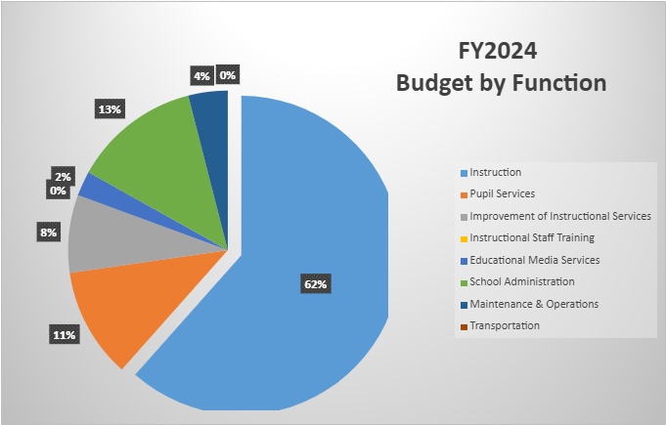
Budget by Function (Required)
*Based on Current Allocation of School Budget

Slide 12

Questions?

Slide 13
The GO Team needs to TAKE ACTION (vote) on the presented budget. After the motion and a second, the GO Team may have additional discussion. Once discussion is concluded, the GO Team will vote.
Action on the Budget

Slide 14

BASC-3 Data

Slide 15
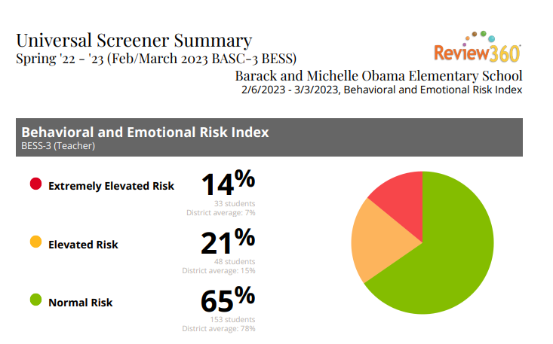

Slide 16
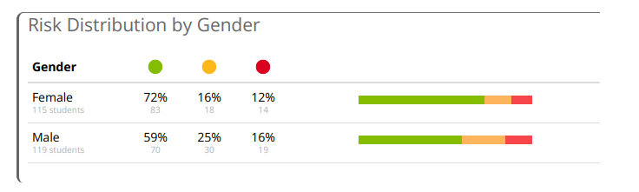

Slide 17
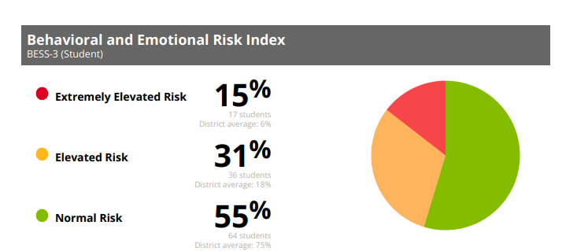

Slide 18
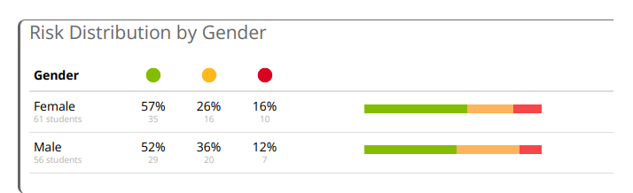

Slide 19

2023 Spring ACES
Accountability
Collaboration
Equity
Support

Slide 20
International Baccalaureate
01
Glow | Grow
All instructional staff have started our IB POIs. We have also created our school planner with Dr. Murphy’s support. | Scheduling to ensure adequate time to meet and plan for upcoming units.

Slide 21
Indicator | Time Frame
 | Fall 2022 | Spring 2023*
Attendance Take Rate | 98.3% | 99%
ADA Attendance Rate | 93.4% | 92.5%
Students not chronically absent | 78.6% | 78.5%
0.21**
Subgroup | Total number of students | OSS Suspension Rate
 |  | Fall 2022 | Spring 2023*
Female | 128 | 0 | 0.04
Male | 133 | .60 | 0.36
SWD | 49 | .12 | 0.15
Black | 242 | 0.25 | 0.22
Hispanic | N/A | N/A | N/A
Multi-race | N/A | N/A | N/A
White | 10 | 1.55 | 0
Asian | N/A | N/A | N/A
*As of 01/10/2023
Spring 2022 students not chronically absent: 50%
As of February 21, 2022
**A suspension rate of 1 indicates that the average student in the school (including all students, not just those ever suspended) will be suspended for one day over the course of the year. A suspension rate of 0.5 is equivalent to 50% of students suspended for one day over the course of the year.
*As of xx/xx/2022

Slide 23
Program | Avg. Daily Use (Mins) |  | Avg. Weekly Use (Days)
 | Fall 2022 | Spring 2023* | Fall 2022 | Spring 2023*
Read 180 | Not available | 19.8 minutes | Not available | 1.9 days
System 44 | 19.4 minutes | 14 minutes | 1.7 days | 2 days
iRead | 22.8 minutes | 25 minutes | 1.5 days | 1.5 days
*As of 01/20/2023

Slide 24
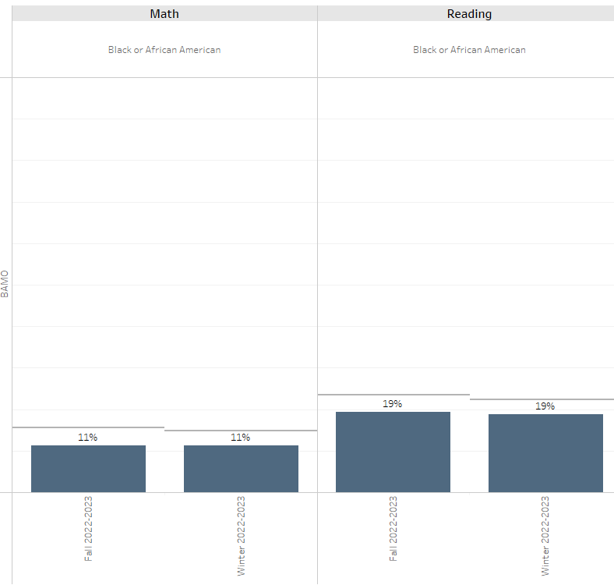
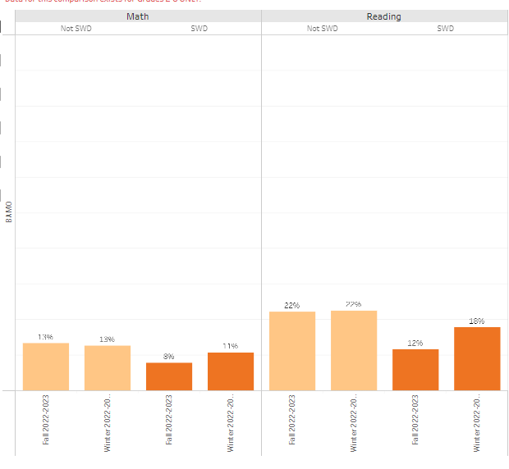

Slide 25
 | CIP Strategy | Action Step Progress Update
ELA | We will use the Accountable, Consistent, Evaluations (ACE) strategy to increase school-wide implementation of phonics and literacy curriculum. | Teachers are currently engaged in weekly planning and knowledge sessions. One area of growth is looking to provide teachers time to digest their planning sessions and prepare materials for instruction. Our focus for this semester is providing more consistent bi-weekly observation feedback with one actionable item.
Math | Provide professional learning opportunities related to content and differentiation of learning. | Teachers are collaborating weekly to plan for math instruction. One area of focus as a leadership team, and instructional team, is calibrating our data protocol process. We have completed the calibration with our leadership team. We are now working to calibrate with our grade level teachers.
Whole Child & Student Support | We will build a stronger connection between school and home with our parents to decrease the percentage of chronically absent students by 5%. The percentage will go from 49.6% to 44.6% | Parents receive daily phone calls when a child is absent. We track absence reasonings to be able to determine next steps of support. We hold our bi-weekly attendance meetings as part of our NEST (Care) Team. The team works to determine next steps for scholars falling below the 90% mark.
Family Engagement | By May 2023, we will increase the percentage of parents in grades (K-3) participating in our APTT program by 5% from the previous year’s attendance. | We held our initial session with parents during our Literacy Night in October. Teachers have been meeting with parents and conducting individual conferences during the month of January. Our next event will be held in March. We have had to adjust timelines to allow for appropriate planning for teachers in grades K-3.

Slide 26
To be able to maintain our district supports from the fall, even though we are no longer on the APS Turnaround list. Based on our data, those supports are needed and have assisted us in creating important instructional routines within the building.

Slide 29
Questions?

Slide 30

Thank you

